Slide 1
Topic: Interest
EQ – How is Compound Interest different from Simple Interest?
Get your VIVOS
Sam invests 15000 at 7.5% for 5 years.
How much simple interest will he get back on his investment
What is the gross amount of his investment after 5 years
SI = P (15000) x R(7.5%) x T(5)
SI = 15000x(7.5/100)x5
SI = 15000 x 0.075 x 5
SI = 5625
This means that at the end of 5 years, she would have earned $5625 on top of the $15,000 so the total gross amount would $20,625 at the end of 5 years.

Slide 2
Compounding the problem.
Compound interest is when you earn interest each time, based upon on previous amount.
If we look at the same problem from before, but apply compound interest we see it grow a lot quicker-
Initial Amount | Simple interest PxRxT | New amount
15000 | 15000x0.075x1 | 16125
From the SI, we earned only $5625, but compounded we earn $6534.44, a difference of $909.44

Slide 3
ANSWERS:
Compound interest is when you earn interest each time, based upon on previous amount.
If we look at the same problem from before, but apply compound interest we see it grow a lot quicker-
Initial Amount | Simple interest PxRxT | New amount
15000 | 15000x0.075x1 | 16125
16125 | 16125x0.075x1 | 17334.38
17334.38 | 17334.38x0.075x1 | 18634.45
18634.45 | 18634.45x0.075x1 | 20032.04
20032.04 | 20032.04x0.07x1 | 21534.44
From the SI, we earned only 5625, but compounded we earn $6534.44, a difference of $909.44

Slide 4


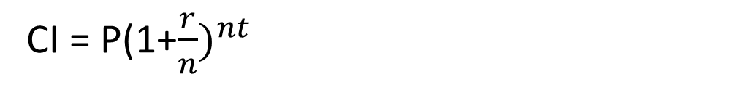
24
7
30
Date
Compound Interest
EQ – How is Compound Interest different from Simple Interest?
What is the formula used to calculate Compound Interest?
CI = P(1+$\frac{r}{n})^{nt}$
Accumulated amount
a) Annually?
b) Twice a year?
c) Quarterly?
Notes:
A is the account value,
t is measured in years,
P is the starting amount of the account, often called the principal, or more generally present value,
r is the annual percentage rate (APR) expressed as a decimal, and
n is the number of compounding periods in one year.

Slide 5
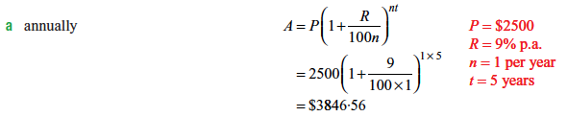
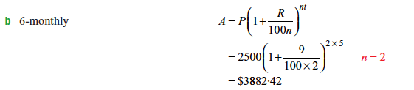
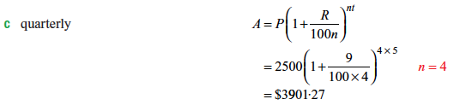
24
7
30
Date
Compound Interest
EQ – How is Compound Interest different from Simple Interest?
What is the formula used to calculate Compound Interest?

Slide 6
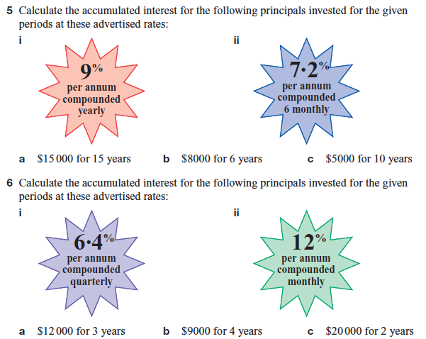
Task

Slide 7
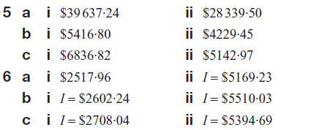
Answers

